Slide 1
Contractor Forum
VHBA | Active Client Model and OHS Contract Clauses

Slide 2
Welcome to VHBA’s Contractor Forum
The objective of this session is to raise awareness of the:
Victorian Infrastructure Delivery Authority’s (VIDA) Active Client Model
Victorian Health Building Authority’s (VHBA) OHS Contract Clauses
During this forum, please raise any questions that you have via the Slido app using this QR code or the joining link displayed on each slide.
We will collate these and use them to develop an FAQ document that will be distributed following this session.

Slide 3
Presenters
Name | Position | Slide #
Sebastian Chilton-Brand | Project Safety Advisor | 1-3. & 15.
Tracy-Lee Cooke | Director, Safety | 5.
Trent Burke | Senior Executive Director (HCP) | 6-8.
John Feil | Safety Systems Manager | 9-10. & Clauses
Tess Ingram | Senior Project Safety Advisor | 9-10. & Clauses
Kate Kennedy | Principal Project Manager (HCP, PSRACS) | 11.
Justin Balasa | Project Director (HCP, Community Hospitals) | 12.
Andrew Martin | Principal Project Manager (HCP, Community Hospitals) | 13.
Sophia Motamed | Principal Project Manager (HCP, PSRACS) | 14.

Slide 4
A Message from the VHBA CEO

Slide 5
Being an Active Client - Background
Organisational issues and management actions contribute to workplace accidents (Reason, 1990).
Analysis of construction accidents can be attributed to professional or managerial failures arising well before work commences on site, most notably in the planning and design stages (Bomel, 2001, Suraji et al 2001; HSE 2003).
Client requirements identified by UK researchers as one of the most significant root causes of construction site accidents (HSE 2003)
‘initiators’ of projects and purchasers of the construction industry’s product, clients are in the best position to drive the cultural change in relation to OHS improvements (Levitt and Samelson 1993).
US-based research revealed that the involvement of the client in pre-project planning, financially supporting the constructor’s safety program and participating in the day-to-day project OHS activities were important requisites for excellent project OHS performance (Huang and Hinze 2006a; 2006b).
“Governments are major employers, policy makers, regulators and purchasers of equipment and services. They have a leadership role in preventing work-related death, injury and disease in Australia” (ASCC, 2006, p9).

Slide 6
Overall client OHS oversight ‘models’*
Active client
Thin client
Low control Low monitoring Low expertise
High control Close supervision Client expertise
Controlling client
Review of key documents and engagement on safety incidents Considered monitoring against contract Some internal expertise on overall subject matter
Mandated model of the Director-General. Applied by VHBA and all other VIDA Project Offices.
*Advice from Herbert, Smith, Freehills August 15

Slide 7
Overall client OHS oversight ‘models’*
The mandated model of the Director-General, as applied by VHBA and all other VIDA Project Offices, ensures the following:
Lends itself to increased attention on safety matters and contributes to overall safer project outcomes.
Client seeks to appoint well-qualified and competent contractors and pass on any necessary knowledge of the risks and hazards.
During the works, the client actively engages with the contractor to carry out due diligence of proactive safety performance. Where issues are identified, the client seeks assurances or steps be taken by the contractor to rectify these.
By using this approach, VHBA are serious about working with our contractors to foster relationships that lead to optimal safety outcomes, innovative collaboration and continual improvement.

Slide 8
Limitations
We look to influence, collaborate with and seek assurance from our contractors delivering our projects.
We do not seek to control or manage construction-based activities which are properly the responsibility of the contractor performing or overseeing the physical works.

Slide 9
OHS Clauses
Sets clear expectations relating to key health and safety risks
It does not mandate how these risks are to be managed
A series of OHS clause documents are available; these are scalable to project complexity.
AS2124 Brownfield/Greenfield (small and large projects)
AS4300 Brownfield/Greenfield (small and large projects)
PPP and MC OHS Clauses

Slide 10
OHS Clause requirements
Services Management
Drugs and Alcohol Management
Hazardous substances/materials
Principal Site Visits
Incident Notification and Reporting
Communications and Consultation
Audits (quarterly)
Document Access
OHS Resourcing (Safety and Services)
Reporting (monthly and completion)
Sharing known project safety risks
OHS project risk workshops and register
SiD workshops and register
Project HSMP (reviewed 6 monthly)
PPE requirements
Heavy Vehicle National Law
Occupational Health and Hygiene
Emergency Management
Mental Health and Wellbeing
Fatigue Management

Slide 11
Time considerations
Facilitating workshops for risk management, emergency management and communications. These workshops need to include relevant external stakeholders (VHBA, Dept Health, Emergency Services etc)
Project Risk Assessment to be provided to VHBA Project Safety Team 10 days prior to initial risk workshop
Third party audit prior to commencement on HSMP and procedures
Following third party audits, HSMP review by VHBA Project Safety Team (approx. 2 week turn around)
Potential to request further information or clarification where a contract requirement has not been met, or a key process is unclear
Potential to resubmit HSMP to the auditor to complete a further review if contract clauses have not been met
Potential to resubmit to VHBA Project Safety Team for final review

Slide 12
Pre-commencement Prerequisites
Contractor to select an independent OHS auditor to review their HSMP against statutory requirements and OHS contract clauses.
Auditor and audit scope must be approved by VHBA Project Safety Team prior to HSMP review being conducted.
A project OHS risk register must be developed and shared with VHBA
Contractor to facilitate an OHS project risk workshop. The risk register is to be updated to reflect any new hazards and resubmitted
Contractor to facilitate emergency response risk workshop
Hygiene risk assessment and management plan to be completed
HSMP to be updated if required
Review and approval of the HSMP by independent auditor
Copy of HSMP and the independent auditor’s declaration that HSMP meets legal and contractual requirements provided to VHBA Project Safety Team
VHBA Project Safety Team undertake review of HSMP, and if required, raise issues or comments
Once all VHBA Project Safety Team comments have been addressed, construction work can commence at the direction of the project team

Slide 13
Periodic VHBA Site Visits
Contractors must facilitate regular site visits with the VHBA Project Safety Team. VHBA will advise of the frequency of these visits.
These site visits are intended to be led by the contractor and construction activities seen and discussed are based on the scope of works at the time of the visit.
The contractor will be informed of any VHBA findings at the end of the site visit / inspection. Contractors will not be provided a copy of VHBA site documentation.
For this reason, the contractor needs to complete their own record of the site visit during these visits.

Slide 14
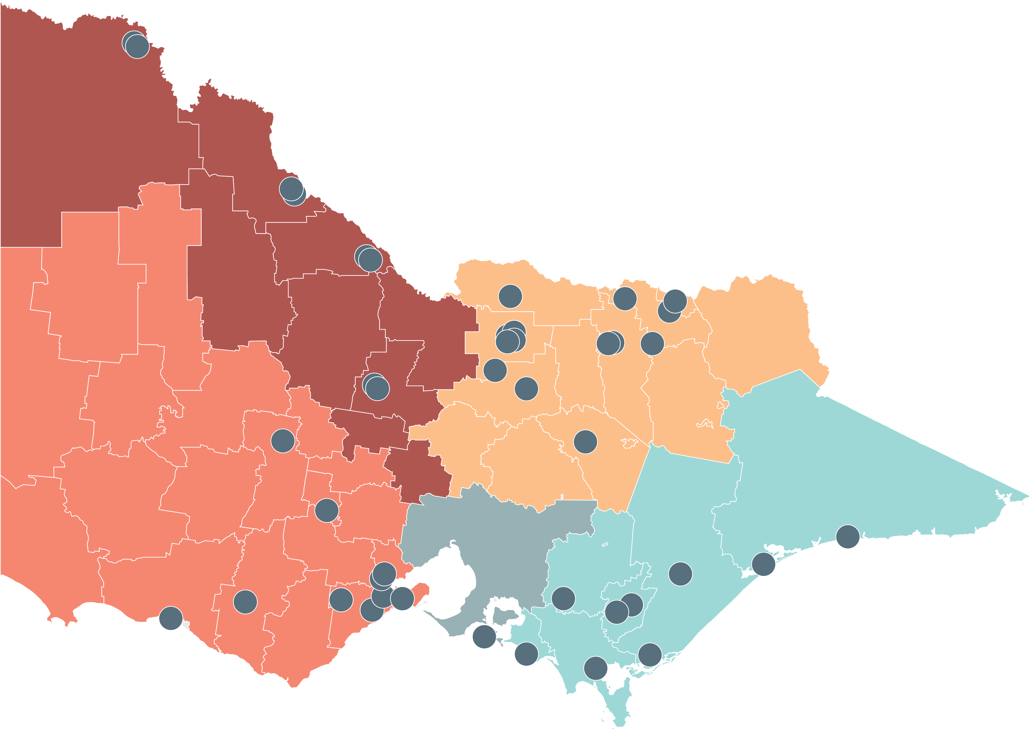
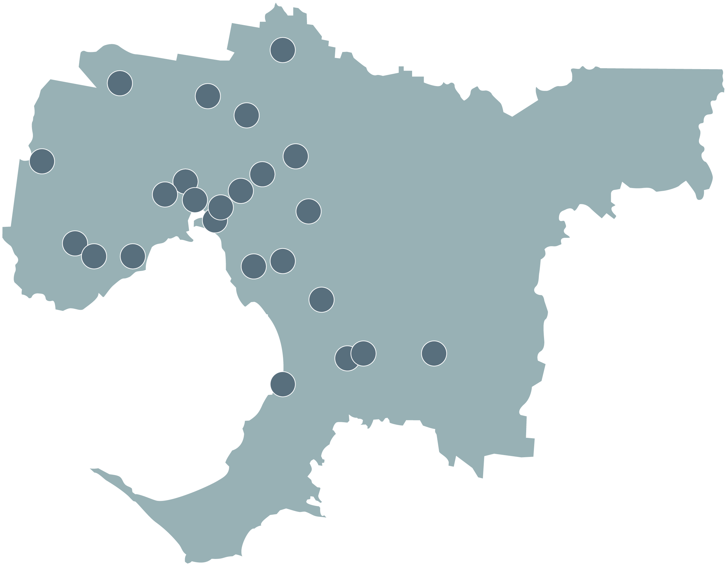
Delivering state-wide projects and programs
Significant progress continues on major projects and programs across the state
North East Victoria
Numurkah Hospital campus aged care upgrade
Albury Wodonga Health Emergency Department expansion
Albury Base Hospital redevelopment
Shepparton Early Parenting Centre
Shepparton Youth Prevention & Recovery Care Centre
New ambulance branches – multiple sites
Acute mental health beds – multiple sites
Public Sector Residential Aged Care upgrades – multiple sites
Shepparton Early Parenting Centre
Whittlesea Community Hospital
PET scanners – multiple sites
South West Victoria
Warrnambool Base Hospital redevelopment
Barwon Women’s and Children’s
New ambulance branches – multiple sites
Acute mental health beds – multiple sites
Camperdown aged care upgrade
Emergency department expansions – multiple sites
Geelong Early Parenting Centre
Youth Prevention & Recovery Care Centre –multiple sites
Community Hospitals – multiple sites
PET scanners – multiple sites
North West Victoria
Cohuna District Hospital aged care upgrade
Swan Hill emergency department redevelopment
Mildura Base Public Hospital theatre upgrades
Mildura AOD
Ballarat Base Hospital Redevelopment
Sunraysia Community Health Services upgrades
Cohuna aged care upgrade
Bendigo Early Parenting Centre
Bendigo Youth Prevention & Recovery Care Centre
Sunbury Community Hospital
Metro Melbourne
Northern Hospital Expansion
Queen Elizabeth II Hospital redevelopment
Dandenong Hospital expansion
Monash Medical Centre Tower Expansion
Austin Hospital emergency department upgrade
Thomas Embling Hospital expansion project
Metropolitan Health Infrastructure Fund
Royal Melbourne Hospital & Royal Women’s Hospital upgrades
New Footscray Hospital
Frankston Hospital redevelopment
New ambulance branches – multiple sites
Emergency department expansions – multiple sites
Early Parenting Centres – multiple sites
Youth Prevention & Recovery Care Centre – multiple sites
Community Hospitals – multiple sites
PET scanners – multiple sites
South East Victoria
New hospital in West Gippsland
Wonthaggi Hospital redevelopment
Maffra District Hospital aged care upgrade
New ambulance branches - multiple sites
Phillip Island Community Hospital
Public Sector Residential Aged Care upgrades – multiple sites
Traralgon Youth Prevention & Recovery Care Centre

Slide 15
Thank you
Please ensure to raise any questions that you have using the QR code below
Notes:
Session will be recorded and available to prospective contractors on the VHBA public facing website.

Slide 16
Thank you

